Slide 3
Appeal Resource Guide
Appeal Instructions

Slide 5
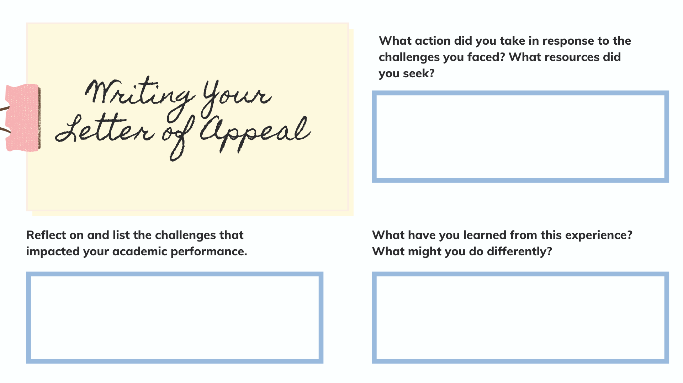

Slide 6
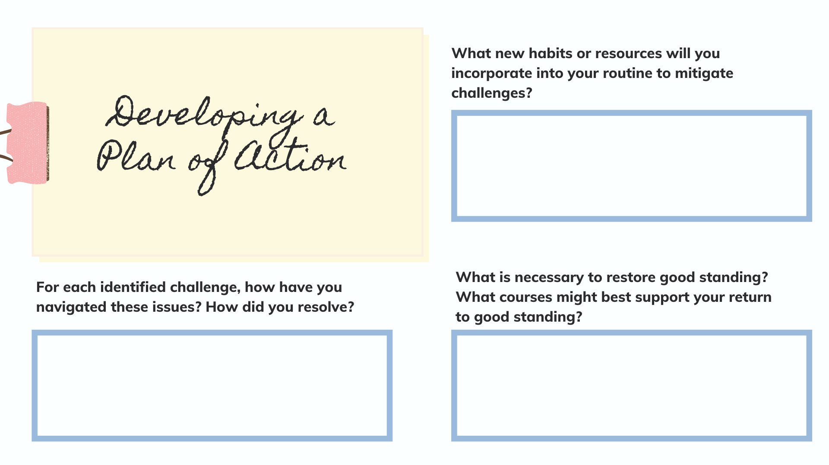

Slide 7
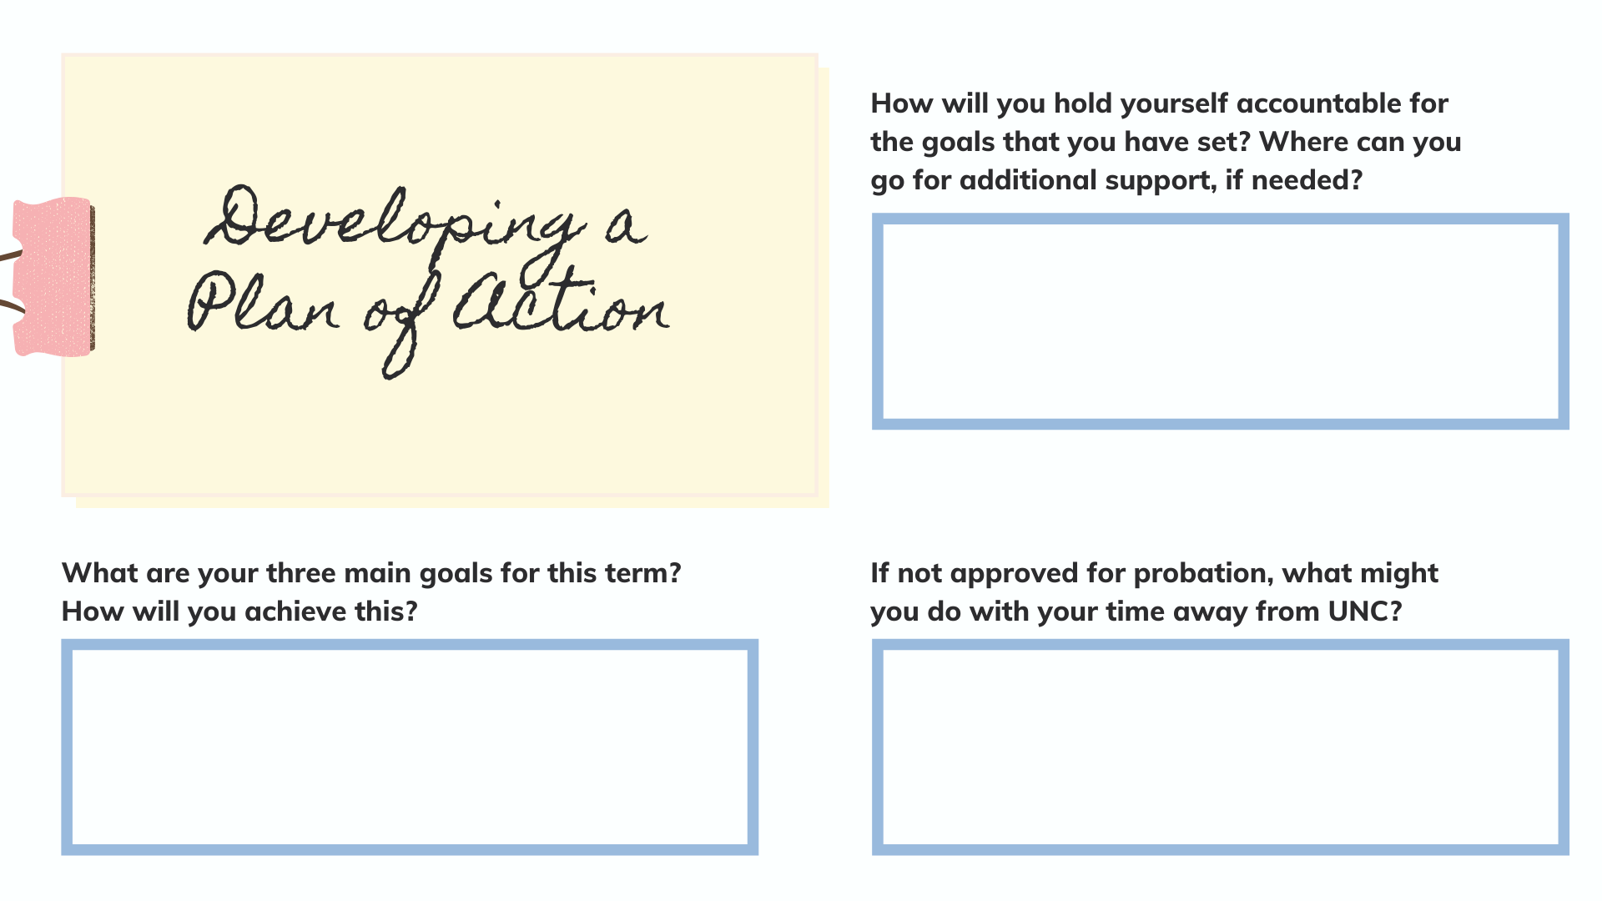

Slide 14
COVID-19 FAQ

Slide 15
Appeal Resource Guide

Slide 16
